Slide 1


Ahmed Hassan
Cyber Security Consultant & Penetration Tester @ Condignum, AUSTRIA (Vienna)
How to identify CVEs in Open-Source Projects/Applications? Let's hack!

Slide 2

Agenda
Self-Introduction
What is a CVE?
Where can you find a suitable open-source Application for Testing?
Installing the open-source Application
Identification of a Vulnerability in the open-source Application
Reporting Identified Vulnerabilities: Methods and Platforms
CVE Acceptance and Publication
Questions from the audience & further Explanations (Q&A)?

Slide 3










Self-Introduction
Working since almost 6 years as a Cyber Security Engineer & Penetration Tester @ Condignum, AUSTRIA
Speaker at various international security conferences & Universities (Egypt, UAE, Saudi Arabia, Austria etc.)
Securing the Clients environment (Web, API, Active Directory, Mobile, Infrastructure etc.)
Working since almost 6 years as a Cyber Security Engineer & Penetration Tester @ Condignum, AUSTRIA
Speaker at various international security conferences & Universities (Egypt, UAE, Saudi Arabia, Austria etc.)
Securing the Clients environment (Web, API, Active Directory, Mobile, Infrastructure etc.)
Working since almost 6 years as a Cyber Security Engineer & Penetration Tester @ Condignum, AUSTRIA
Speaker at various international security conferences & Universities (Egypt, UAE, Saudi Arabia, Austria etc.)
Securing the Clients environment (Web, API, Active Directory, Mobile, Infrastructure etc.)

Slide 4



Slide 5

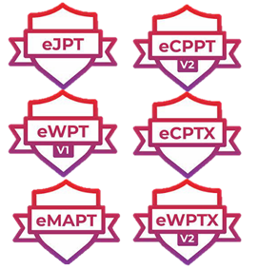

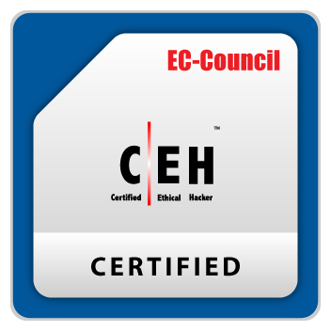

Qualifications & professional Certifications
studied and working in Austria in the Cyber Security Field as Cyber Security Engineer, Penetration Tester and Bug Bounty Hunter
Certifications for advanced IT professionals
Certified EC-council Instructor
Certified Ethical Hacker
Offensive Security Certified Professional
Offensive Security Web Assessor

Slide 6
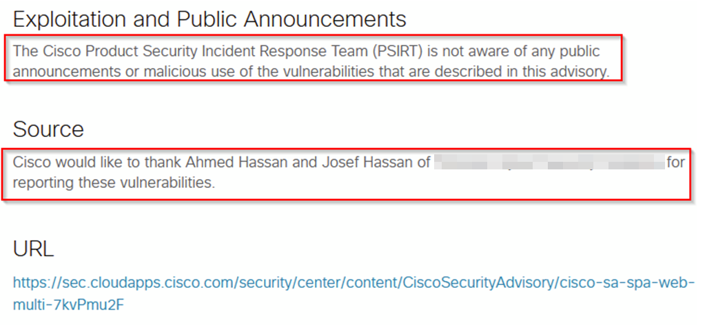
Identified Vulnerabilities & 0-day Vulnerabilities
Identified more than 52 CVEs. Some as an example:
My GitHub Repo-Link: https://github.com/ahmedvienna/CVEs-and-Vulnerabilities
CVE-2024-0351
CVE-2024-0350
CVE-2024-0349
CVE-2024-0348
CVE-2024-0347
CVE-2024-0262
CVE-2024-1972
CVE-2024-1922
CVE-2024-1919
CVE-2024-3735
CVE-2024-7466
Hall of Fame announcement and CVE assignment, for identifying a Zero-day Vulnerability in CISCO’s Devices.

Slide 7
What is a CVE ?

Slide 8
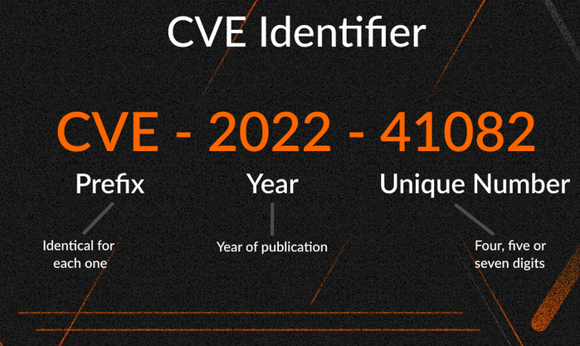
CVE Explanation
The Common Vulnerabilities and Exposures (CVE) system is a framework operated by the U.S. National Cybersecurity FFRDC and maintained by the Mitre Corporation. It provides standardized identification and naming of publicly known security vulnerabilities and other weaknesses in computer systems.
The primary goal of the CVE system is to prevent multiple naming of the same threats by different organizations and institutions. Each known vulnerability is assigned a unique identifier, which consists of the prefix CVE, the year of discovery, and a sequential number (e.g., CVE-2020-1234). This ensures the consistent identification of vulnerabilities and facilitates smooth information exchange between the various databases maintained by individual vendors.

Slide 9
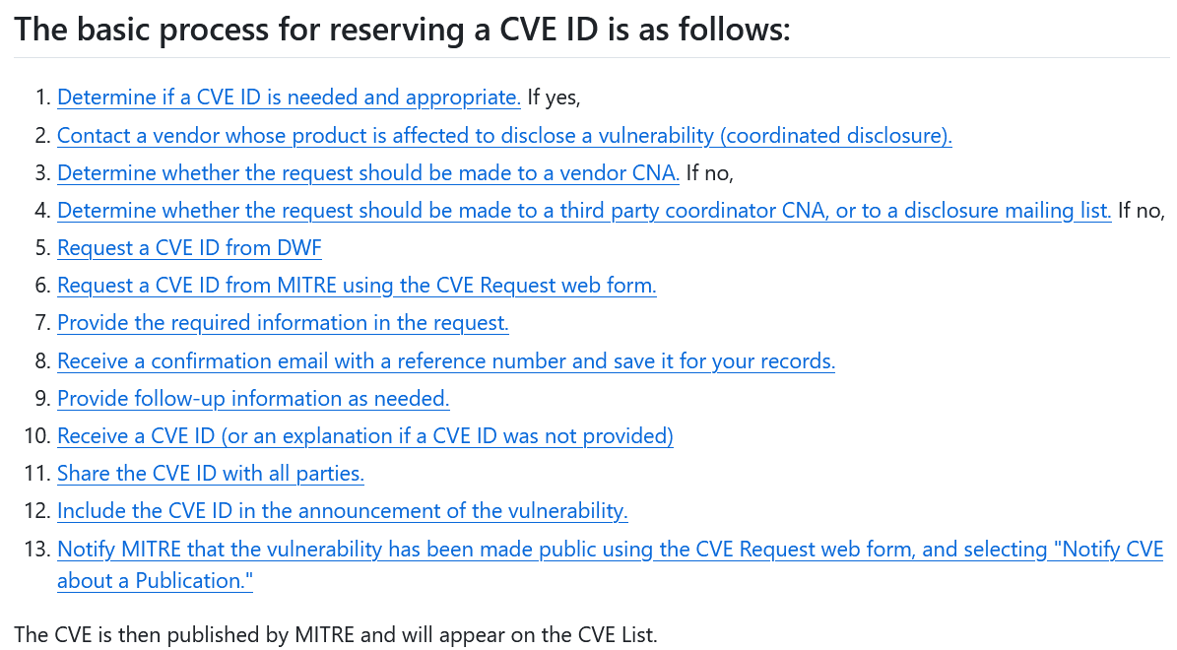
Criteria for requesting a CVE
Detailed Process how CVEs are reported and assigned: https://github.com/CVEProject/cveproject.github.io/blob/master/requester/reservation-guidelines.md
The Common Vulnerabilities and Exposures (CVE) identifier can be requested when a security vulnerability in a software product or system meets specific criteria.
This process typically applies to different applications such as Desktop applications or even Web applications. It is essential to first clarify with the vendor whether they are authorized to request or assign CVEs.

Slide 10
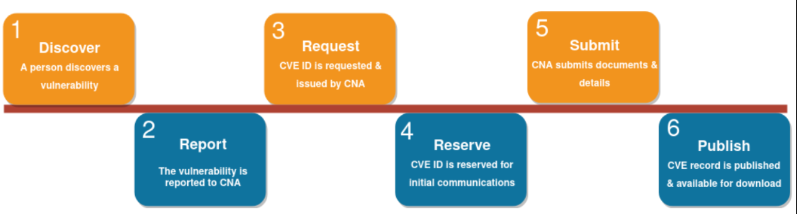
Workflow for CVE Assignment
This outlines the complete workflow, from identifying the vulnerability to receiving a CVE assignment.

Slide 11
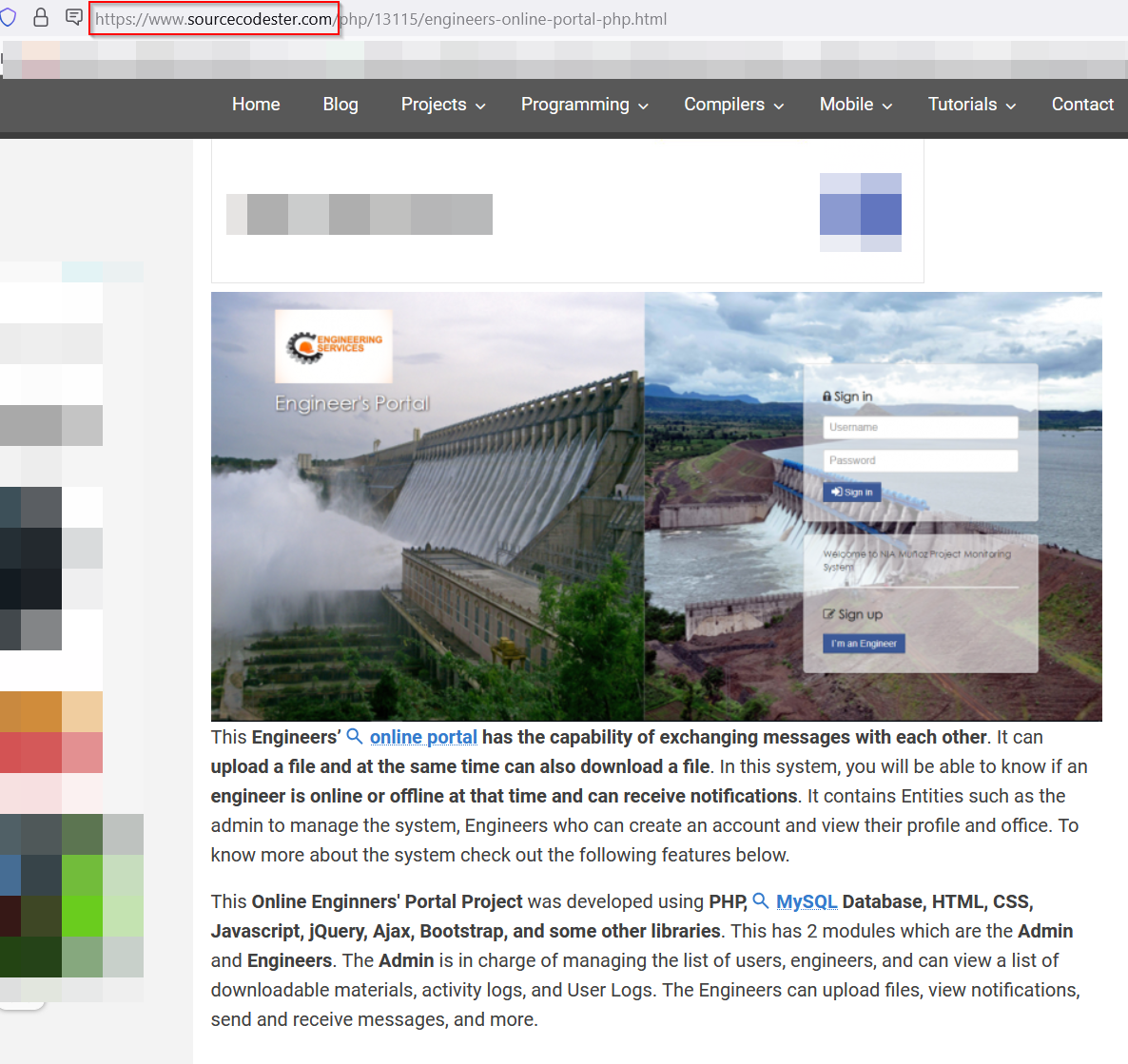
Where can you find a suitable open-source Application for Testing?
This website hosts a vast collection of open-source applications, of which 99% are legitimate candidates for requesting a CVE.
The Website link: https://www.sourcecodester.com/

Slide 12
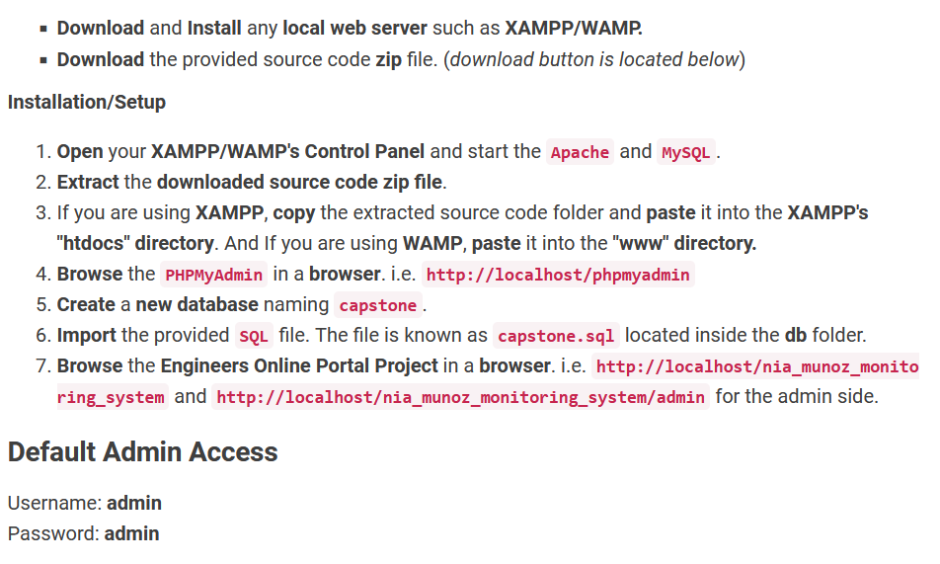
Installing the open-source Application
The installation of the application is well-documented, making it easy and straightforward to download.

Slide 13
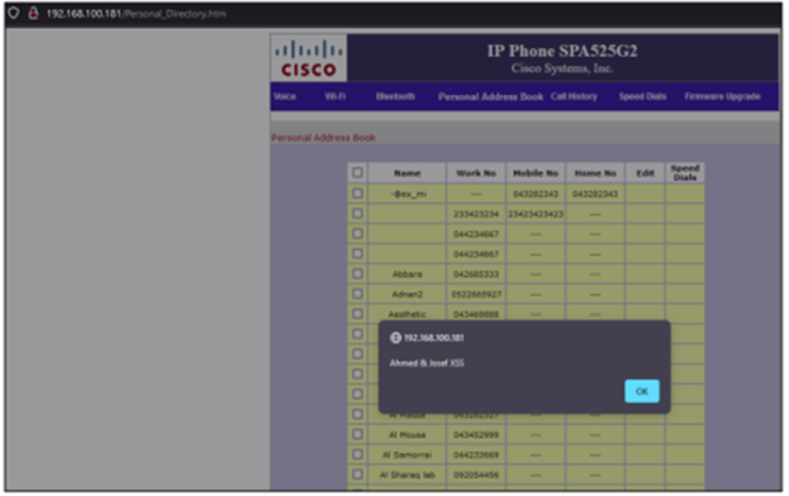
Identification of a Vulnerability in the open-source Application
Assuming we have identified a vulnerability in this open-source application, it is important to thoroughly document all details before proceeding to the reporting phase.
In this phase, we need to collect screenshots, videos, Payloads used and both the request and response data to ensure we provide the vendor with all necessary information.

Slide 14
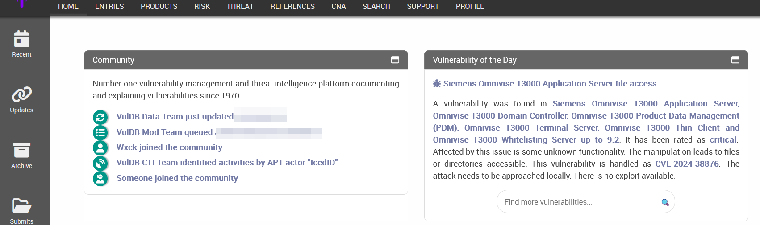
Reporting identified Vulnerabilities: Methods and Platforms
If you can locate the vendor details, such as those for Cisco, and contact their security team, this should be your first step. They may respond and have the capability to assign a CVE.
In cases where you cannot find the security team or if the company shows no interest in the security aspects of their products, you will need to reach out to a recognized CVE authority for assistance in assigning a CVE after reviewing your vulnerability.
The recognized CVE authority Website: https://vuldb.com/

Slide 15
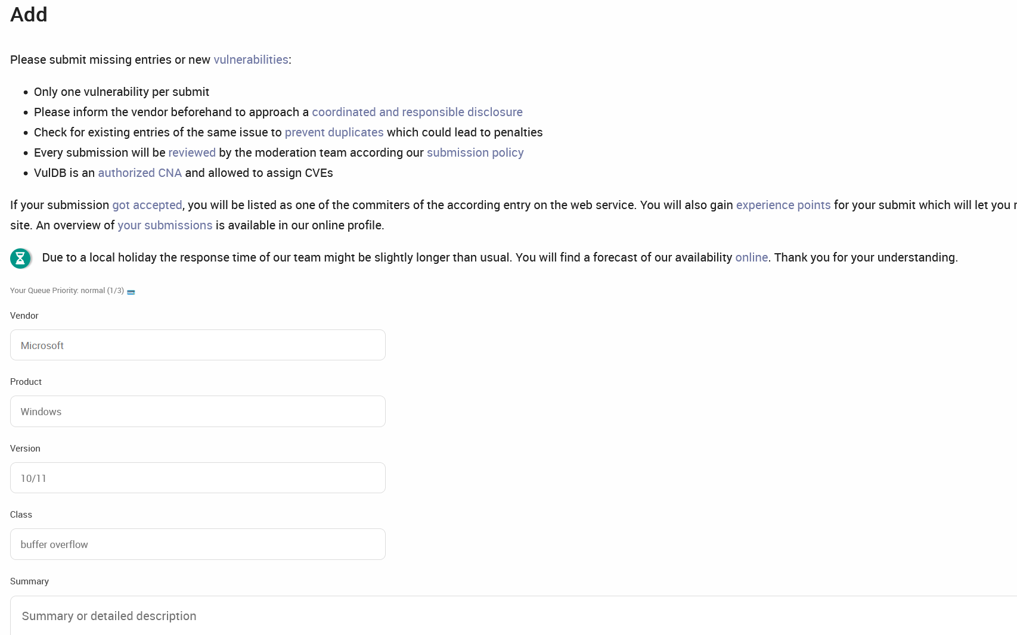
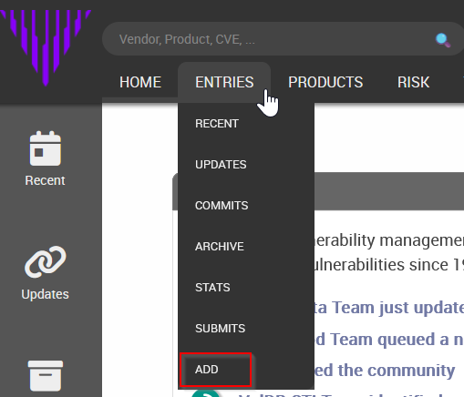
Detailed Procedure for reporting a Vulnerability
To proceed, navigate to the ADD section. Here, you will need to complete all the fields with the information you have, such as details of the vulnerability, proof of concept, and any other relevant data.
1
2

Slide 16
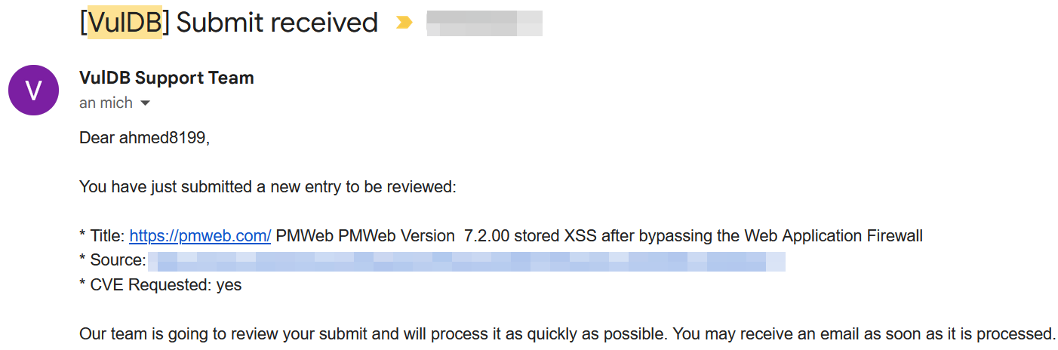
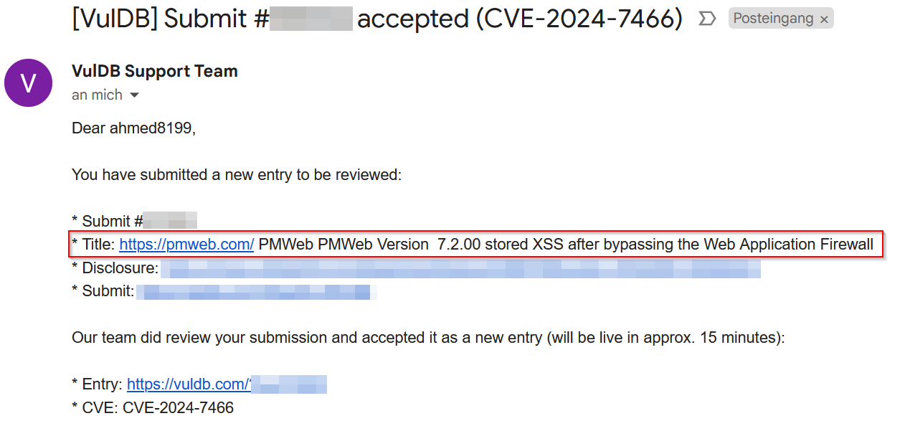
Submitting the form and receiving the Response
Here we can review the message received after submitting the CVE request, along with the response confirming the approval and issuance of a new, valid CVE.
1
2

Slide 17
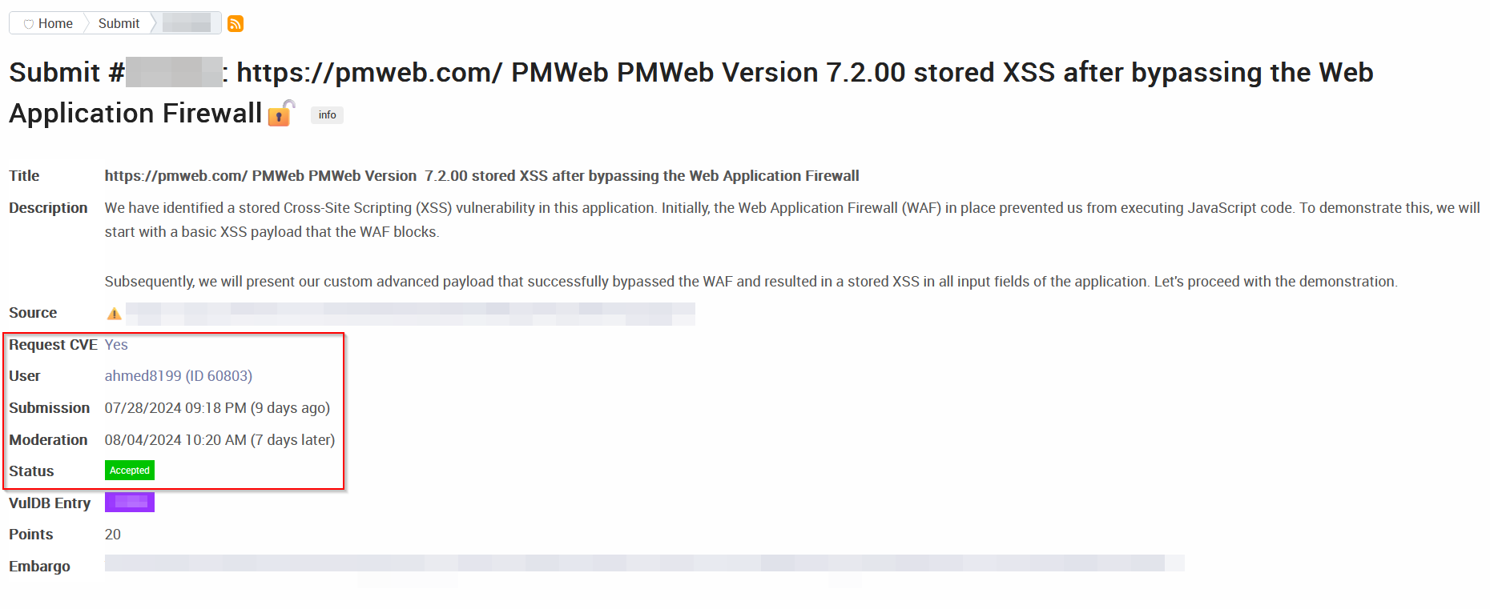
Successful CVE Acceptance and Publication

Slide 18


My LinkedIn: https://www.linkedin.com/in/ahmed-hassan-79559487/

